Slide 1
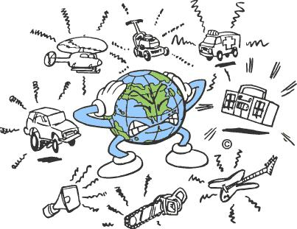
Noise Pollution
This does not include me

Slide 2
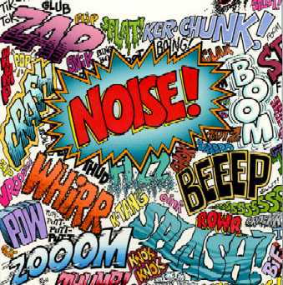
Definition and Types
Definition
Harmful or annoying levels of noise, as from airplanes, industry etc.
Types
Industrial Noise : Noise from industries
Road Traffic Noise : Noises from cars and stuff
Residential and community noise : Normal day to day activities that produce noise

Slide 3
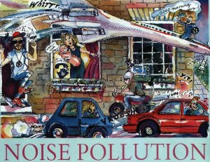
Location
Delhi, India – the nosiest
Cairo
Tokyo
New York City
Madrid

Slide 4
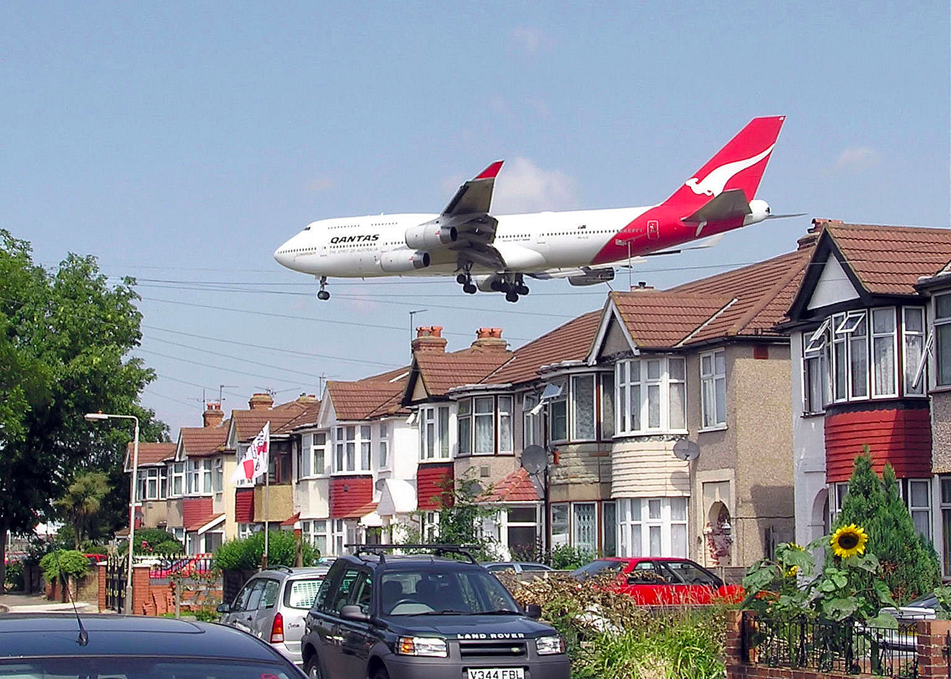
Pollution Causes
Transportation
Industrialization
Poor Urban Planning
Social Events
Construction Activities

Slide 5
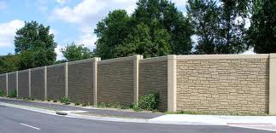
Environmental Causes
Affects learning and behavior.
Health Issues
Sleeping disorders
Effect on wildlife
Trouble Communication

Slide 6
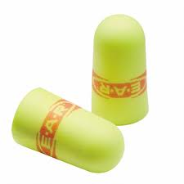
Pollution Conservation Efforts
Hospitals and campuses are silence zones honking is prohibited
Wear ear plugs in areas there is loud noises to prevent hearing loss
Putting trees along roads in busy areas helps absorb sounds.
Noise producing industries, airports, bus and transportation terminals and railway stations are sighted far from living places
Avoid honking your horn when not necessary.

Slide 7
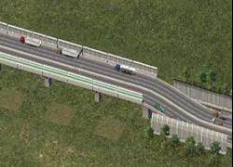
Costs
Sound Barriers: $175 - $200 a square meter
Ear plugs: A pack for $5
Sound proof walls: For one panel about $33

Slide 8
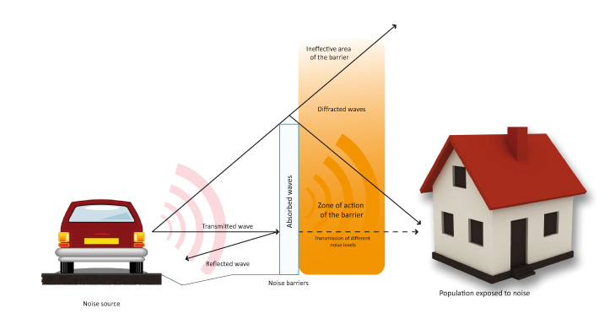
Applicable Legislations
Noise Control Act
Motor vehicle noise performance standards
Off- road and highway vehicles
Maximum environmental noise levels

Slide 9
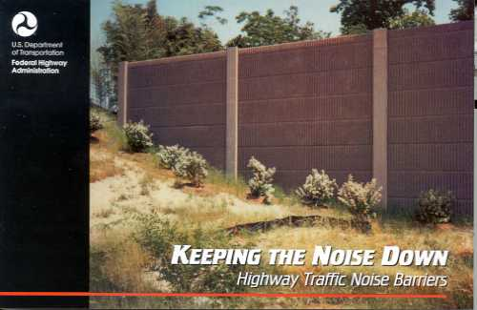
Extra Facts
Noise is a form of sound that is unwanted, while sound, is something that people enjoy.
One of the most neglected forms of pollution
Doesn’t have federal body that would regulate noise pollution
Threatening all types of species
Affects learning

Slide 10
Video
https://www.youtube.com/watch?v=-VaaTn_g1_k

Slide 11
Works Cited
http://rashidfaridi.com/2013/03/19/noise-pollution-sources-and-types/
http://uptenlist.com/facts/top-10-noisiest-cities-in-the-world/2/
http://www.preservearticles.com/2012011320628/what-are-the-main-causes-of-noise-pollution.html
http://www.conserve-energy-future.com/causes-and-effects-of-noise-pollution.php
http://www.wikihow.com/Prevent-Noise-Pollution
http://eschooltoday.com/pollution/noise-pollution/noise-pollution-prevention.html
http://www.ecy.wa.gov/laws-rules/noise.html

