Slide 1
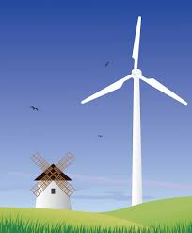
Wind Energy
“It’ll blow you away”

Slide 2
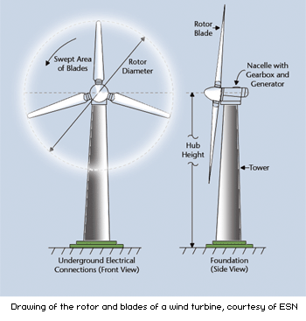
Definition & Types
Wind Energy: also called ‘wind power’ is extracted from air flow using wind turbines or sails to produce mechanical or electrical energy
Basic Information
Horizontal- axis
Vertical- axis
Wind turbines are the most popular source for wind energy
Windmills are also very popular

Slide 3
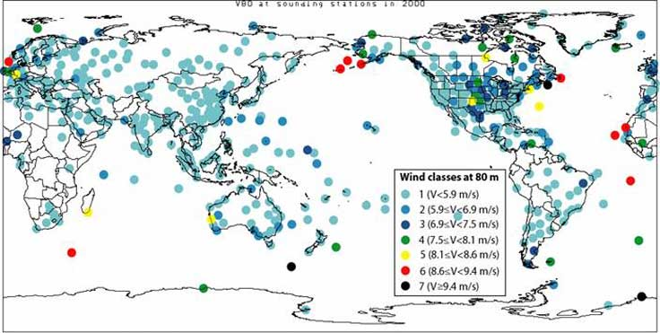
Location
These are current areas that are using wind energy
United States
India
Germany
France’s
Spain and Portugal

Slide 4
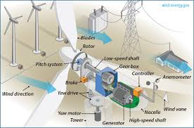
Energy Resource
The following are benefits of wind energy
They’re a clean fuel resource
It’s sustainable
Cost efficient
They can be built on existing farms or ranches
They can create jobs

Slide 5
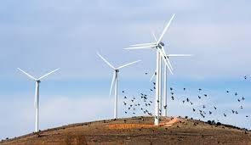
Environmental Consequences
The following are consequences of wind energy
Competition with conventional generation source costs
Good wind sites are usually in remote areas
Might not be most profitable
Turbines could cause noise pollution
Turbine blades could damage local wildlife

Slide 6
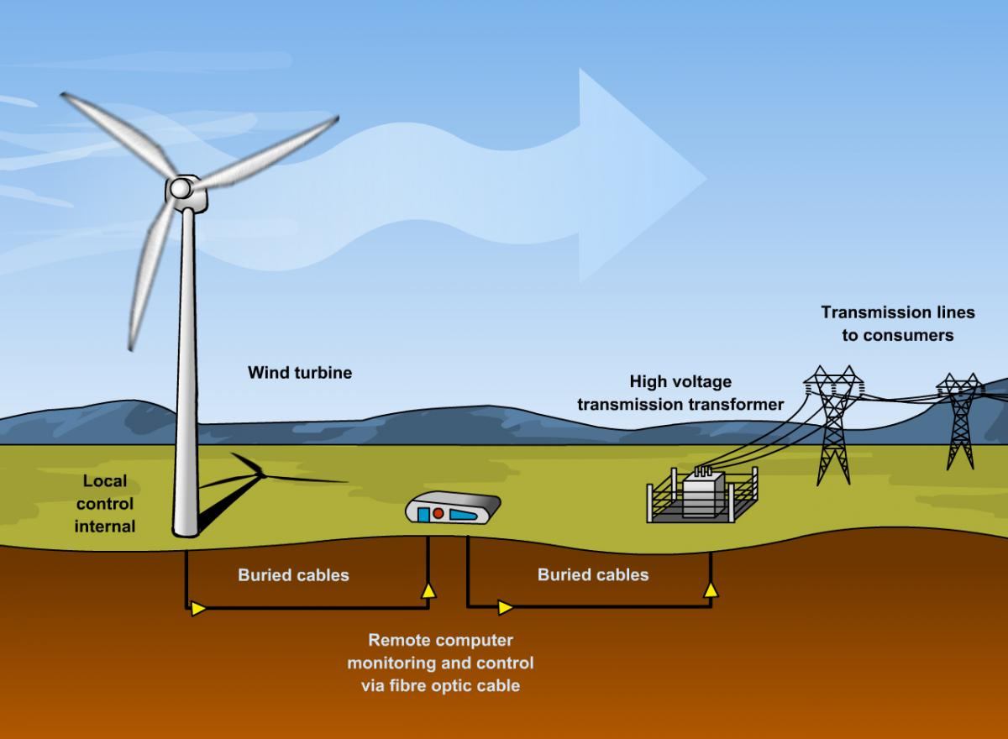
Resource Use
The following are uses of wind energy
Energy generation
Wind- powered vehicles
Wind powered cargo ships
Sporting events
Wind powered water pumps

Slide 7
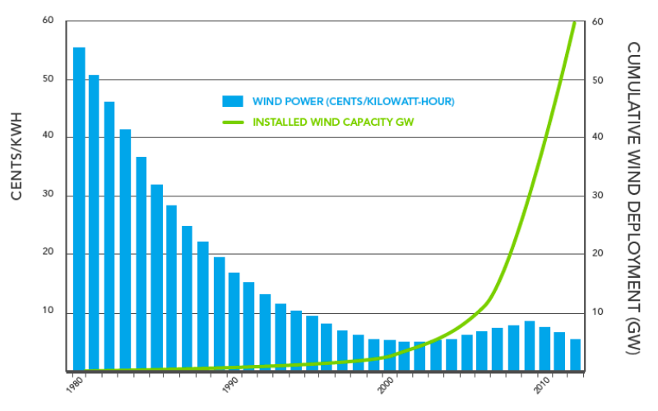
Costs
How much does wind energy cost?
Wind energy is one of the most affordable forms of electricity today
Recent improvements in turbine technology has lowered the cost of wind energy
Depending on the kilowatt capacity, wind turbines can cost a range of $3,000- $48,000
The larger house, the higher price
The smaller house, the lower price

Slide 8
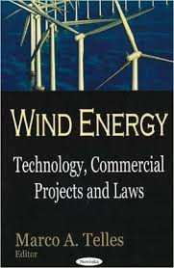
Applicable Legislations
The following are laws of wind energy
Noise Control Act
Clean Air Act
National Historic Preservation Act
Air Commerce and Safety Act
National Environmental Policy Act

Slide 9
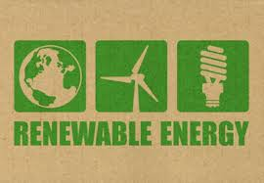
Extra Facts
The following are facts about wind energy
Windmills have been in use since 2000 B.C.
The largest turbines can harness energy to power over 600 American homes
Farmers used wind power to pump water for grinding grain
Around 80 different countries use wind energy to generate electricity
Smaller turbines are sometimes used to charge batteries or backup power

Slide 10
Literature Cited
http://biofriendly.com/blog/green-alternatives/renewable-energy/5-smart-uses-for-wind-powered-energy/
http://energy.gov/eere/wind/advantages-and-challenges-wind-energy
http://energy.gov/eere/wind/advantages-and-challenges-wind-energy
http://www.mariah-energy.com/2011/01/top-10-countries-where-wind-turbines-are-used-most-efficiently-%E2%80%93-updated-article-with-new-information/
http://bergey.com/wind-school/residential-wind-energy-systems
http://www.awea.org/Resources/Content.aspx?ItemNumber=5547
http://teeic.indianaffairs.gov/er/wind/legal/index.htm
http://www.conserve-energy-future.com/various-wind-energy-facts.php
http://www.sciencekids.co.nz/sciencefacts/energy/windenergy.html

