Slide 1
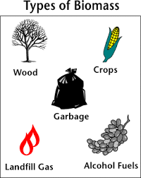
Biomass Fuel Energy
Planting the biomass in your life
By: Mya Cavanagh

Slide 2
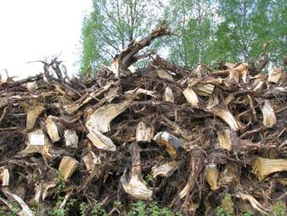
Definition and Types
Biomass Fuel Energy - energy contained inside plants and animals
Types -
Woody fuels
used in wide varieties of biomass technologies
Forestry residues
disposed of by stacking & burning
Chemical recovery fuels
responsible for over 60% of total biomass energy consumption
Urban wood & yard wastes
landfills are getting rid of wood waste

Slide 3
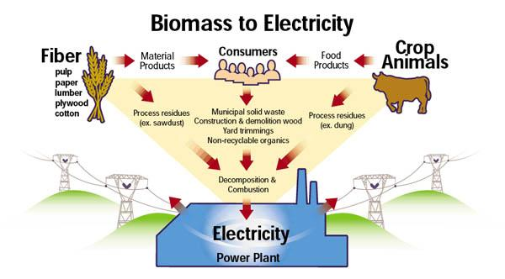
Location
Use of biomass energy - mainly used
in 3rd world countries
Canada
India
Africa
Australia
Denmark
Used to produce electricity

Slide 4
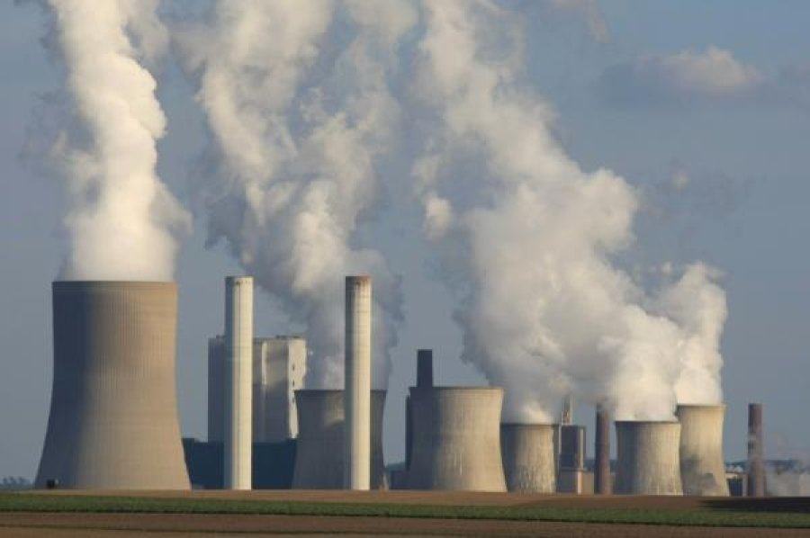
Resource Benefits or Pollution Causes
No harmful emissions -
no harmful carbon dioxide emissions
Clean energy -
carbon dioxide doesn’t provide any more harm
Abundant and renewal -
products never run out
Reduce landfills -
harmful waste > something useful
Versatile -
different products can be created

Slide 5
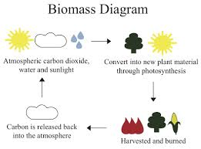
Environmental Consequences
Transporting biomass -
noisy and has emission problems
Air quality -
air quality implications
Water levels -
high water levels
Unstable conditions -
biomass taken from unsustainable sources
Negative impacts -
forest management and farming crops

Slide 6
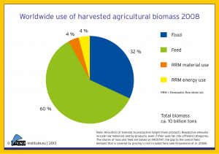
Resource Uses or Pollution Conservation Efforts
Food -
all food contains biomass
Charcoal Production -
left-over matter after wood is burned
Liquid Fuels -
used as substitute for gasoline or diesel fuel
Generation of Heat -
combustion process results in heat generation
Production of Gaseous Fuels -
can be converted to biogas

Slide 7
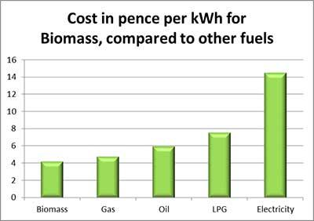
Costs
Biomass Plant Cost -
biomass plant = $3,500-$4,400
Capital Cost -
$2.32 million
Staffing levels -
$200,000
Fuel cost and return -
$1,787,269
Revenue -
$4,807,269

Slide 8
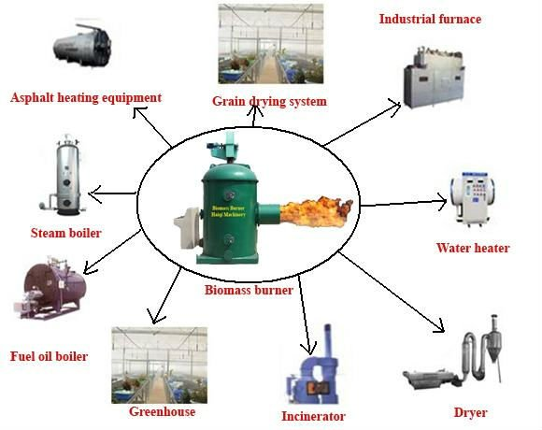
Applicable Legislation
Food, Conservation, and Energy act of 2008 -
two definitions
Energy Independence and Security act of 2007 -
new definition
Biomass Thermal Utilization act of 2015 -
30% tax credit
American Renewable Biomass Heating act of 2010 -
Tax credit
Local Energy Supply and Resiliency act of 2013 -
technical assistance program
Biomass Heating Equipment

Slide 9
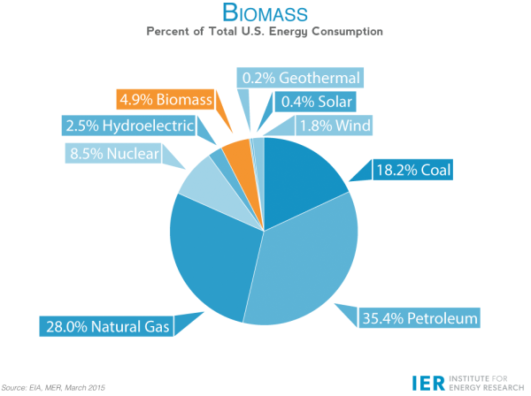
Extra Facts
14%+ world’s primary energy consumption
4% electricity generation in 2010
50% of US renewable energy
2009 - biomass 3% energy consumed United States.
2013 - 4.6 quadrillion energy units consumed in US

Slide 10
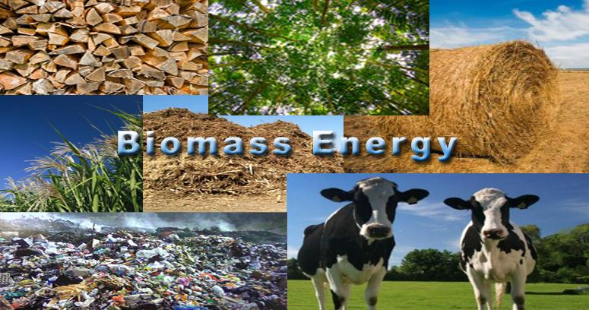
Literature Cited
http://www.hurstboiler.com/biomass_boiler_systems/biomass_fuel_types
http://711590735619247586.weebly.com/how-and-where-is-biomass-being-used.html
http://www.conserve-energy-future.com/Advantages_Disadvantages_BiomassEnergy.php
http://corporate.vattenfall.com/about-energy/renewable-energy-sources/biomass/
http://www.local.gov.uk/climate-change/-/journal_content/56/10180/3510894/ARTICLE
http://teeic.indianaffairs.gov/er/biomass/restech/uses/index.htm

Slide 11
Video Element
https://www.youtube.com/watch?v=slQRWbRE8VI

