Slide 1
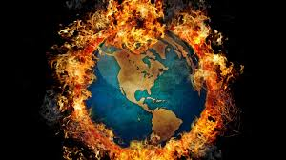
Global warming
Burn baby burn

Slide 2
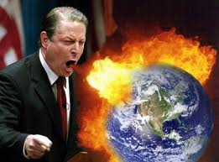
Definition & Types
Global warming is a gradual increase in earths temperature witch results in the greenhouse effect.
Theories
Bio-thermostat
Solar variability
Ocean currents
Human forcing's besides greenhouse gases
Notes:
Bio- Its like the atmosphere is like its own thermostat it heats up the cools down
Solar- The sun changes the cloud formation ocean currents and wind that causes the climate to change

Slide 3
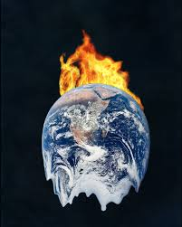
Location
China
United states
Almost everywhere
Notes:
China the us.

Slide 4
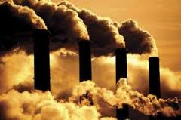
Pollution causes
Factories
Cars
Trucks
Schools
Everything that emits something

Slide 5
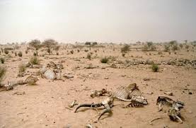
Environmental Consequences
Makes the world hotter
Causes you to have health issues
Dryer weather
Less water
More sun burns

Slide 6
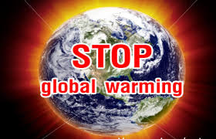
Pollution Conservation Efforts
Reduce co2 Emissions
Ride bike
Reduce all Emissions
Recycle more

Slide 7
Cost
U.s – 22 million
Each household- 1000
Cooling bill- 50 more
Drinks- 50 a month

Slide 8
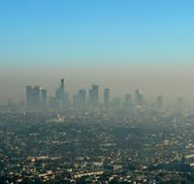
Applicable legislation
Clean air act
Global warming act
General emissions act
Air quality control act

Slide 9
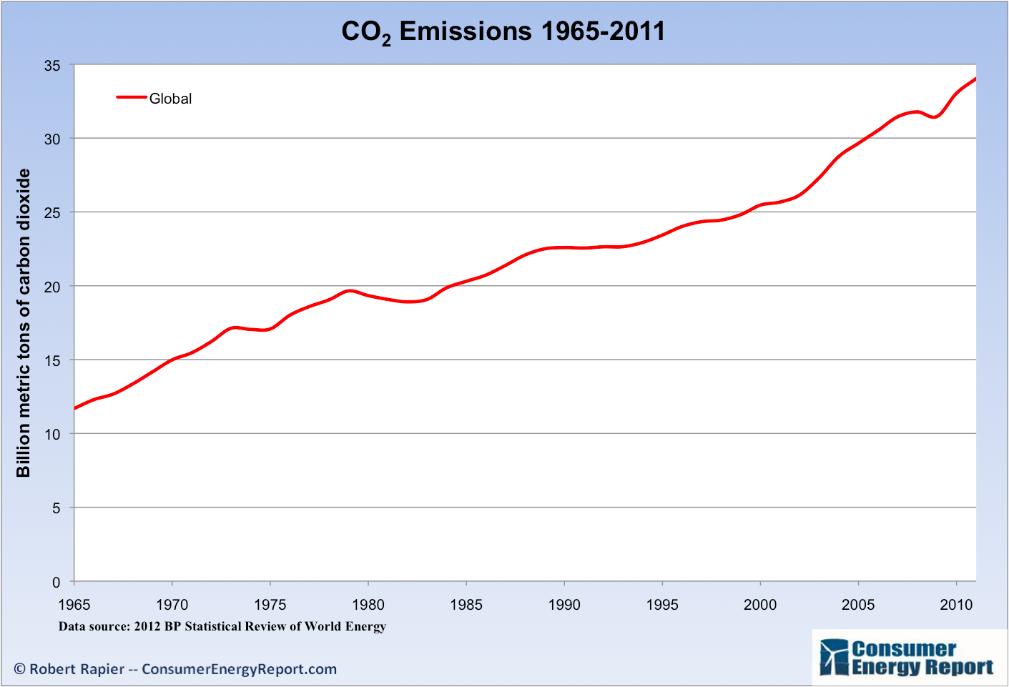
Facts
6 billion tons of carbon dioxide each year
Since 1870 sea level have gone up 8 in
Global warming affects coral reefs
There is more carbon dioxide right now then any point in the last 800,000
Clean air act cut the emissions by 26% in the last 7 years

Slide 10
Video
Global warming

