Slide 1
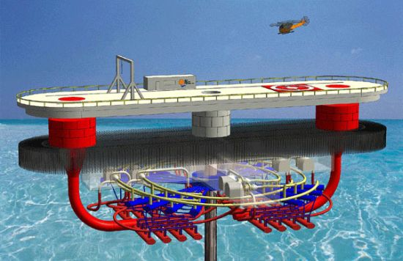
OTEC Energy
Alternative Energy On The Rise

Slide 2
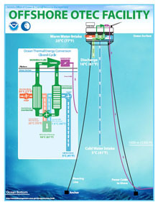
Definition & Types
O.T.E.C. = Ocean Thermal Energy Conversion
OTEC Energy :
“Energy created by using temperature
differences between cooler deep and shallow
warm ocean water”
Types :
Closed – uses fluids with low boiling points
Open – uses warm surface water directly
Hybrid – combination of closed & open

Slide 3
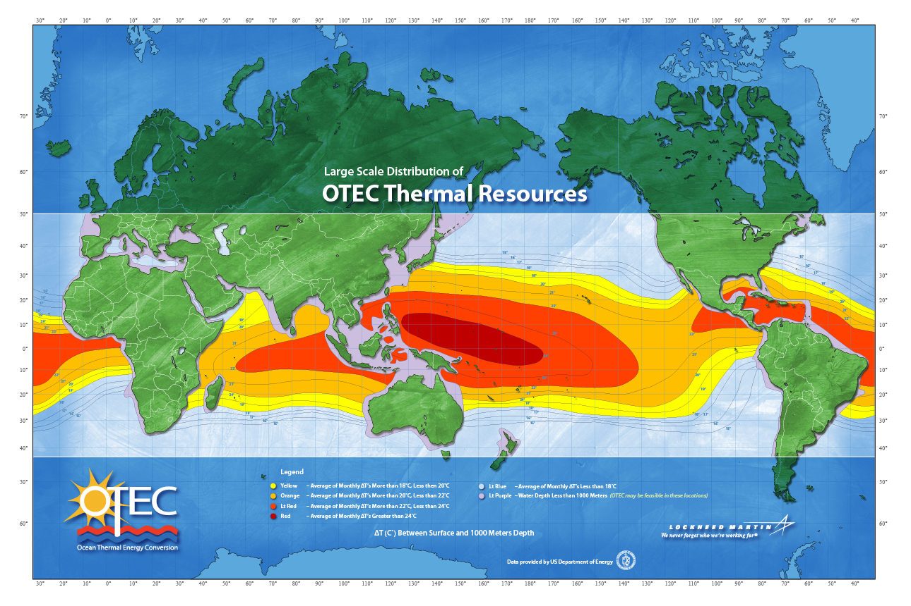
Location
Saga University, Japan – (only OTEC currently operating)
Diego Garcia, Indian Ocean
Hawaii
Hainan Island, China
Bahamas

Slide 4
Resource Benefits
Ocean Water = free resource
Renewable Energy
Recyclable energy
Thermal Efficiency
Slight temperature differences produce large amounts of energy
Limited effects to the environment

Slide 5
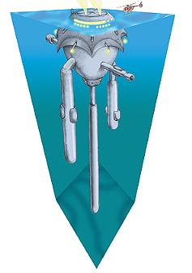
Environmental Consequences
No major environmental concerns
Slight disturbance to ocean / seashore habitats
Cold water returned to the warm surface water
Return water = more nutrient rich
Possible issue for food webs
Ship and platform emissions / wastes

Slide 6
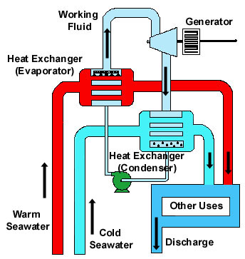
Resource Uses
Largest OTEC Facility
Capable of producing 255 kW of energy
Return Cold Water
Refrigeration
Air Conditioning
Biological Technologies
Nutrient-rich ocean water feed
Distilled fresh water

Slide 7
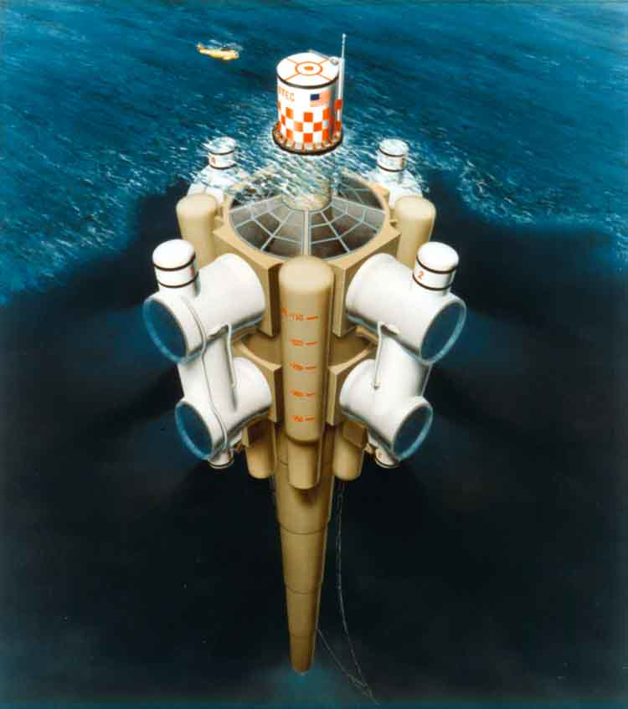
Costs
Cost estimates are uncertain
Not widely deployed
U.S. Navy : $12.5 million research budget
Power Generation Costs
$0.07 per kilowatt-hour
(Wind = $0.05 - $0.07)
Limited waste products
Limited fuel consumption

Slide 8
Applicable Legislation
Ocean Thermal Energy Conversion Act
Developed licensing for facilities in US territory
Enacted in 1980 by President Jimmy Carter
NOAA Office of Ocean & Coastal Resource Management
Issues licenses
OTEC Research, Development, & Demonstration Act
Department Of Energy
Designates demonstration projects
Natural Energy Laboratory Of Hawaii Authority
Developed leading test facility for OTEC technology

Slide 9
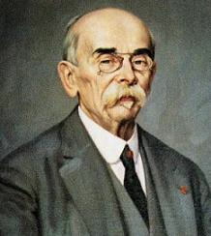
Extra Facts
Idea introduced by Jules Verne
Twenty Thousand Leagues Under The Sea
Proposed by French physicist in 1881
Jacques Arsene d’Arsonval
First built by Georges Claude (1930)
Closed Cycle design patented in 1967
Institute Of Ocean Energy (Japan)
Worldwide leader in OTEC power plant research

Slide 10
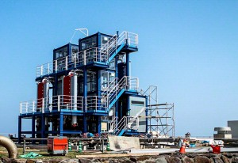
Literature Cited
Holt Environmental Science Textbook
http://en.wikipedia.org/wiki/Ocean_thermal_energy_conversion
http://www.oteci.com/otec-at-work/test-page
http://www.personal.psu.edu/users/l/e/lep5068/
Ocean/OTEC%20History.html
http://oilprice.com/Latest-Energy-News/World-
News/Japan-to-Judge-Viability-of-OTEC-Technology-with-Pilot-Plant.html

