Slide 1
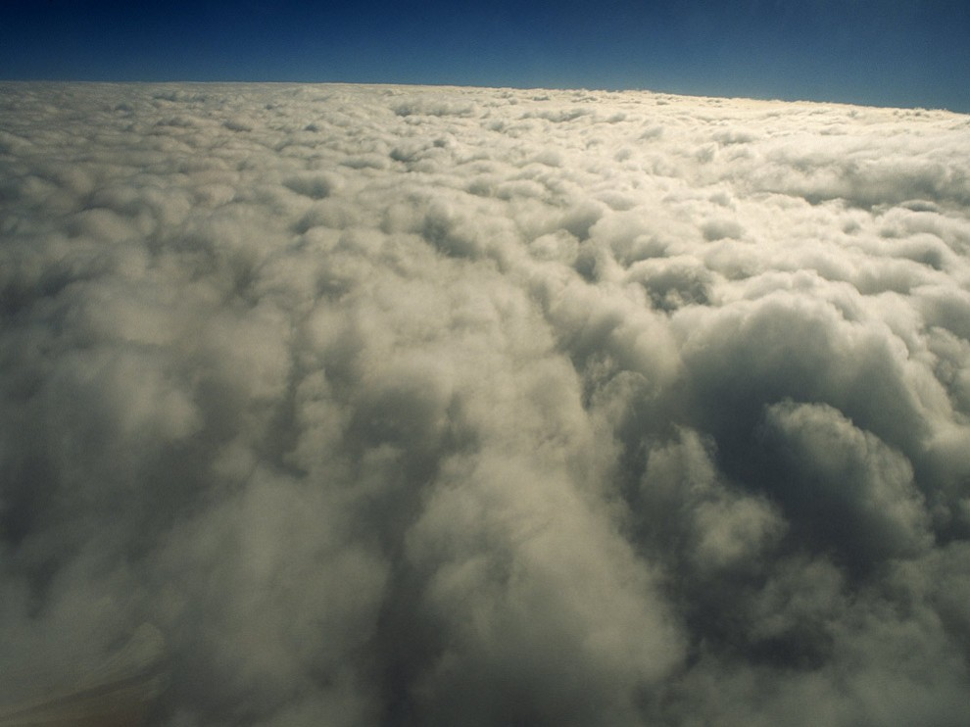
Ozone Depletion
Sam Puck
“ A growing hole of problems”

Slide 2
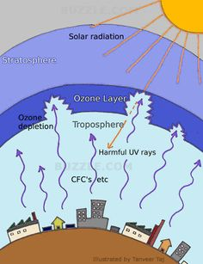
Definition and Types
Destruction of the stratospheric
ozone layer which shields the
earth from ultraviolet radiation
harmful to life.
Ozone Depleting Substances:
Chlorofluorocarbons
Hydrochlorofluoracarbons
Carbon tetrachloride
Methyl chloroform

Slide 3
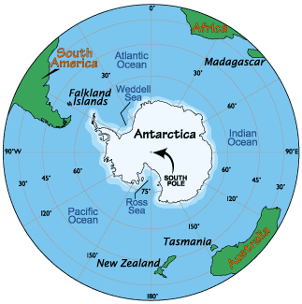
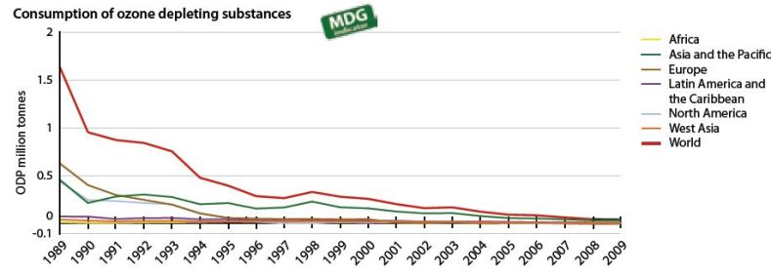
Locations
The Antarctic ozone hole
Consumption of ODS:
North America
Latin America
Asia
Africa
Europe

Slide 4
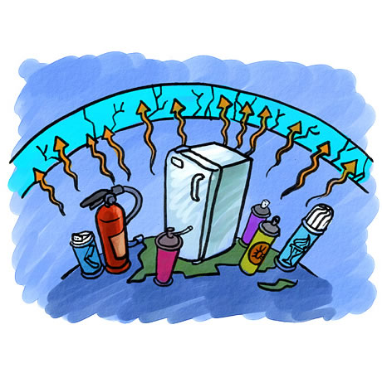
Pollution Causes
Items Containing ODS:
Refrigerators
Air Conditioners
Fire Extinguishers
Dry Cleaning
Cleaning Solutions
Electronic Equipment

Slide 5
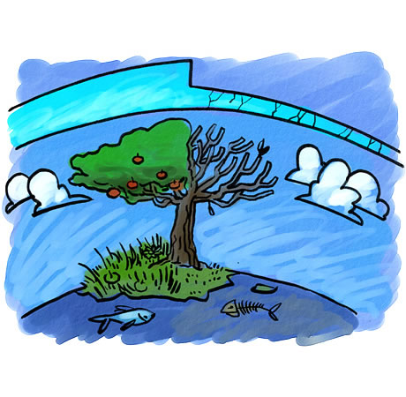
Environmental Consequences
Harm to human life
Negative impacts to plant life
Damage to Marine life
Harm to other animal life
Growing of the ozone
hole and large scale
ozone thinning

Slide 6
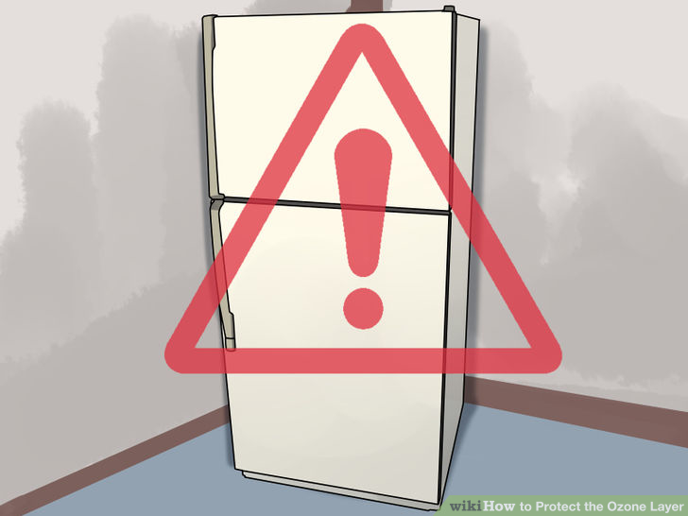
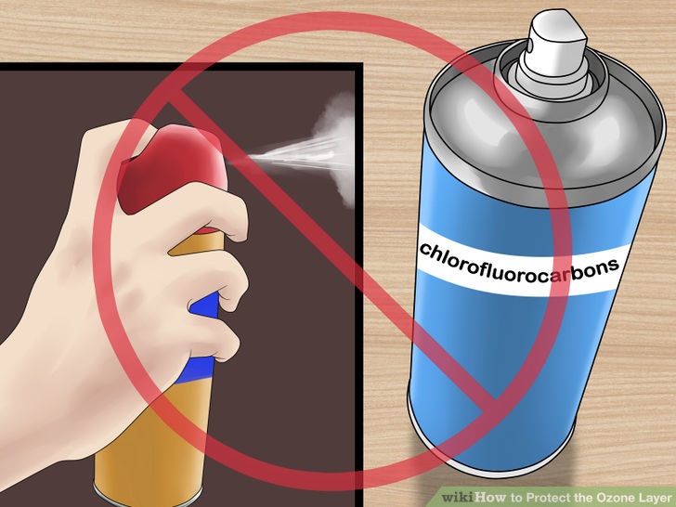
Conservation Efforts
Use non-ozone depleting alternatives
Regulation of imported and
manufactured ODS
Inspections to prevent or
minimize refrigerant leaks
Dispose of refrigerators,
freezers, and air conditioning
units properly
Avoid household aerosols
containing CFCs

Slide 7
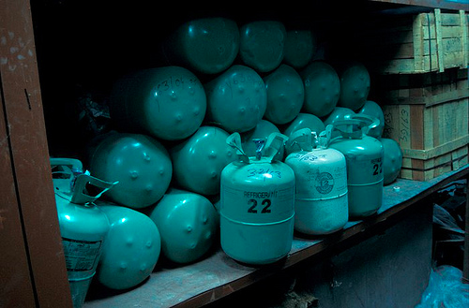
Costs
Costs Americans $2.9 to $5.4 billion in additional health costs
Appliance disposals are $30-$100
Refrigerant leak detection (inspection): $75-$200
Refrigerant leak repair-
$225-$1600
Natural refrigerant
replacement- $160-$400

Slide 8
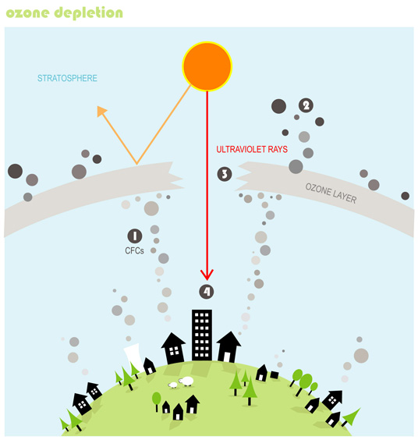
Applicable Legislation
Clean Air Act
Montreal Protocol on ODS
Ozone Depleting Substances
Regulation
Environmental Code of
Practice of Elimination of HCFCs
Ozone Layer Protection
Act of 1996

Slide 9
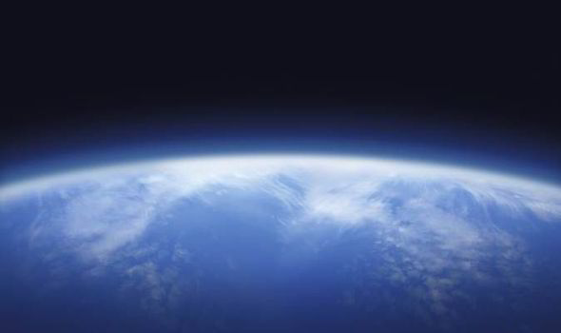
Extra Facts
A decrease of 1% in the ozone layer can cause 5% increased cases of skin cancer.
1970’s research led to the discovery of the ozone hole.
Ozone gases sit about 25-30 kms above Earth’s surface.
CFCs are responsible for about 80% of ozone depletion.
CFCs remain in the
atmosphere for 20-120
years before being destroyed.

Slide 10
Video

Slide 11
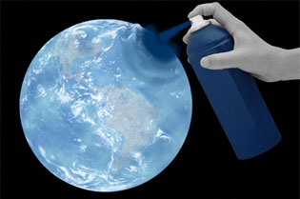
Literature Cited
http://environment.nationalgeographic.com/environment/global-warming/ozone-depletion-overview/
http://www.theozonehole.com/
https://www.epa.gov/ozone-layer-protection/ozone-depleting-substances
http://www.bcairquality.ca/101/ozone-depletion-impacts.html
http://www.epd.gov.hk/epd/english/environmentinhk/air/ozone_layer_protection/wn6_info_olp_ue_c.html

