Slide 1
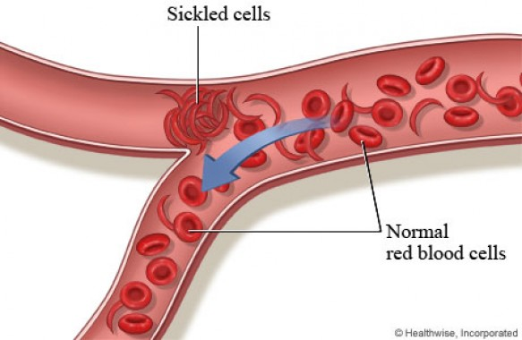
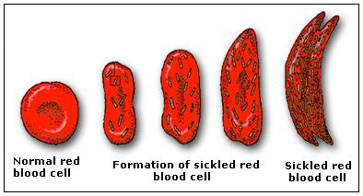
Sickle Cell Anemia
The Race Discriminating Disease

Slide 2
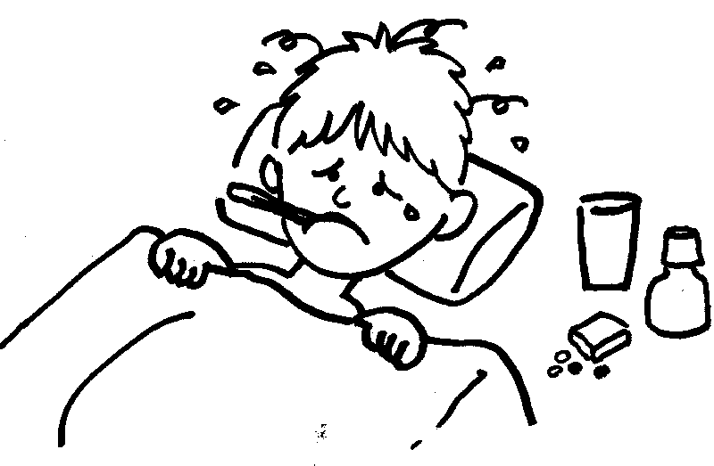
Symptoms
Episodes of pain
Frequent infection
Vision problems
Fever
Abdominal swelling
Pale skin or nail beds
Yellow tint

Slide 3
Occurrence
1,000 babies are born with it each year in the U.S
In the U.S. it occurs more in African Americans & Hispanics
70,000 Americans have sickle cell anemia
Occurs in 1 in 500 African American births
Occurs in 1 in 1000-1400 Hispanic American births
Ryan Clark

Slide 4
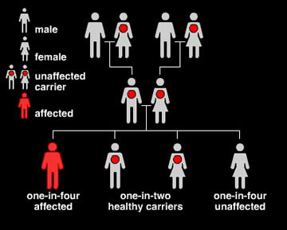
Inheritance
Autosomal recessive genetic disorder
If each parent has AS =
child has 25% chance of having 2 defective genes
Child has 25% chance of having 2 normal genes
Child has 50% chance of being an unaffected carrier
SS gives you sickle cell anemia
AA means no trait
AS are carriers

Slide 5
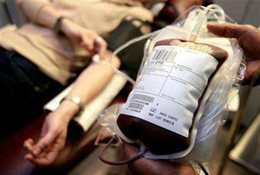
Treatment
Blood transfusions
Plenty of fluids
Pain medicines
Gene therapy
Immunizations to prevent infections
Antibiotics to prevent bacterial infections

Slide 6
Facts
First discovered in the early 1900s
In 1973 life expectancy was 14
Need to get eyes checked more often
Pains episodes are the most common symptom
Sickle cells live 10-20 days and normal live 120 days
Signs of symptoms are during the first year of life

Slide 7
Literature Cited
http://www.mayoclinic.com/health/sickle-cell-anemia/DS00324/DSECTION=risk-factors
http://kidshealth.org/teen/diseases_conditions/blood/sickle_cell_anemia.html
http://www.sicklecelldisease.org/index.cfm?page=scd-global
http://www.ornl.gov/sci/techresources/Human_Genome/posters/chromosome/sca.shtml
http://eclkc.ohs.acf.hhs.gov/hslc/tta-system/health/Health/Health%20and%20Wellness/Health%20and%20Wellness%20Families/SickleCellDisea.htm

