Slide 1
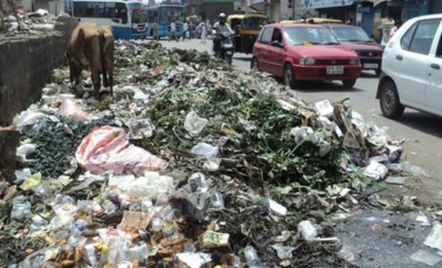
Solid Waste Pollution
Reduce, Reuse, Recycle
by Maddie Johnson

Slide 2
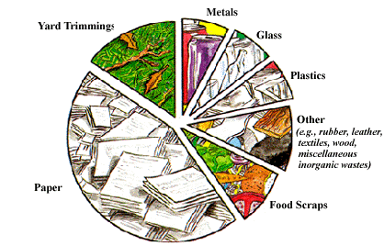
Definition and types
Any garbage , refuse, and sludge from any waste treatment plantation
Types:
Waste Tires
Scrap metal
Furniture and toys
Garbage

Slide 3
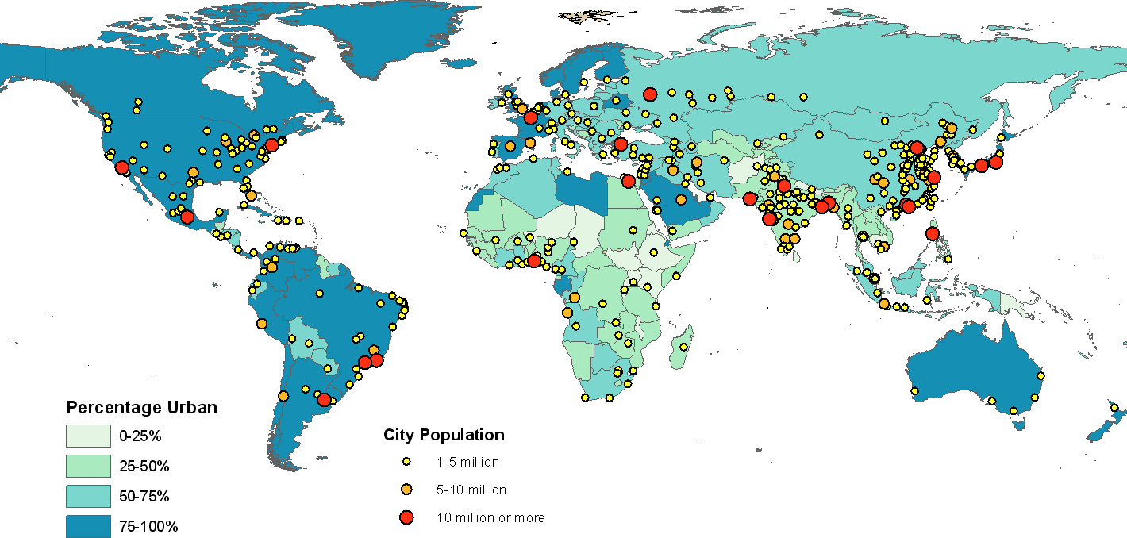
Locations of Solid Waste
Asia
China
India
Germany
U.S.

Slide 4
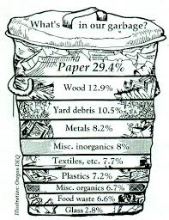
Pollution Causes
People that don’t recycle or take care of environment
Construction of rubble and debris
Plastic wastes
Garbage
Vehicles

Slide 5
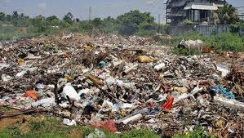
Environmental Consequences
Health hazards
Odors
Air pollution
Vegetation Damage
Fires and explosions

Slide 6
Pollution Conservation Efforts
Reducing the waste when buying products
Reuse containers or products
Recycle the materials
Purchase products that can be recycled
Conduct educational outreach program to clean up wastes

Slide 7
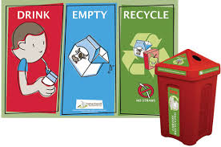
Costs
$20.60 per month for the dwelling unit collections as in garbage, recycling, large items and ect.
$5.00 per month for large 96 gallon garbage disposal cart
$2.00 per month for small 26 gallon garbage disposal cart
Drop offs can cost $2.00-$4.00 per bag

Slide 8
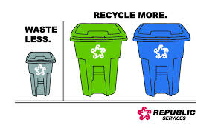
Applicable Legislation
Resource Conservation and Recovery Act- 1976
Land Disposal Program Flexibility Act- 1996
Federal Clean Air Act- 1970
Solid Waste Disposal Act- 1965
Medical Waste Tracking Act- 1988

Slide 9
Facts
The estimated use of Municipal Solid Waste generated worldwide is 1.7 – 1.9 billion metric tons
Every year we generate about 14 million tons of food waste
Americans throw away 28 billion bottles and jars every year
An American produces 4.4 pounds of solid waste per day
Americans make more then 200 million tons of garbage each year

Slide 10
Work Cited
Team, By Work. Pollution Caused by Solid Waste, Rubble, and Construction Debris Is a Serious Threat to the Sea and the Shore of the Gaza Strip (n.d.): n. pag. Web.
Shanghai Manual – A Guide For Sustainable Urban Development In The 21St Centu. C HAPTER 5 – M UNICIPAL S OLID W ASTE M ANAGEMENT : (n.d.): n. pag. Web.
"Disclaimer." What Is Solid Waste. N.p., n.d. Web. 07 Apr. 2015.
"Download PDFs." Environmental Impacts of Solid Waste Landfilling. N.p., n.d. Web. 07 Apr. 2015.
"Resource Conservation." EPA. Environmental Protection Agency, n.d. Web. 07 Apr. 2015.
"Billing: Fees & Charges." - City of Minneapolis. N.p., n.d. Web. 07 Apr. 2015.
"10 FAST FACTS ON RECYCLING." EPA. Environmental Protection Agency, n.d. Web. 07 Apr. 2015.

Slide 11
Video
https://www.youtube.com/watch?v=Qo0K3FfwFgo

